Slide 1
ChatGPT Dev Talk
Mike Benkovich – mike@benko.com – www.benkotips.com

Slide 2
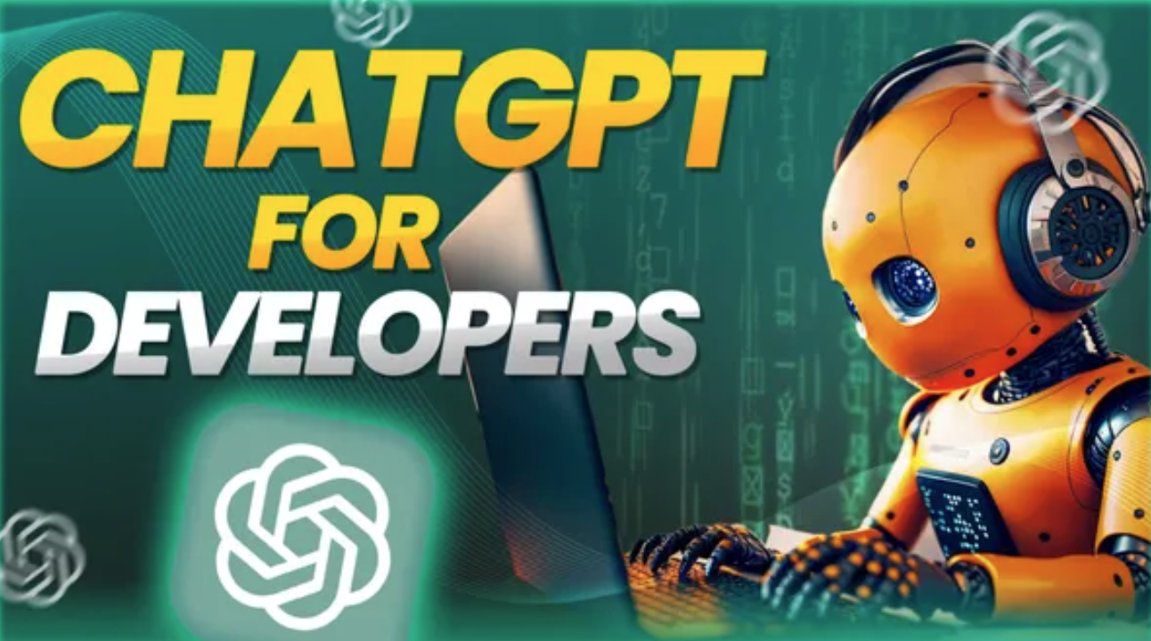

Slide 3

Mike Benkovich
- Developer, Cloud Architect & Consultant
- Live in Minneapolis
- Founder of Imagine Technologies, Inc.
- LinkedIn Learning Instructor
- Blog www.benkoTIPS.com
- Follow @mbenko on Twitter
- Send me Feedback! mike@benko.com

Slide 4
AI - helps you make mistakes much faster and in more interesting, expensive ways.

Slide 5
Today…
Hello ChatGPT
Large Language Models
Chat and Co-pilots
OpenAI Service
Prompt Flow
Next steps…

Slide 6
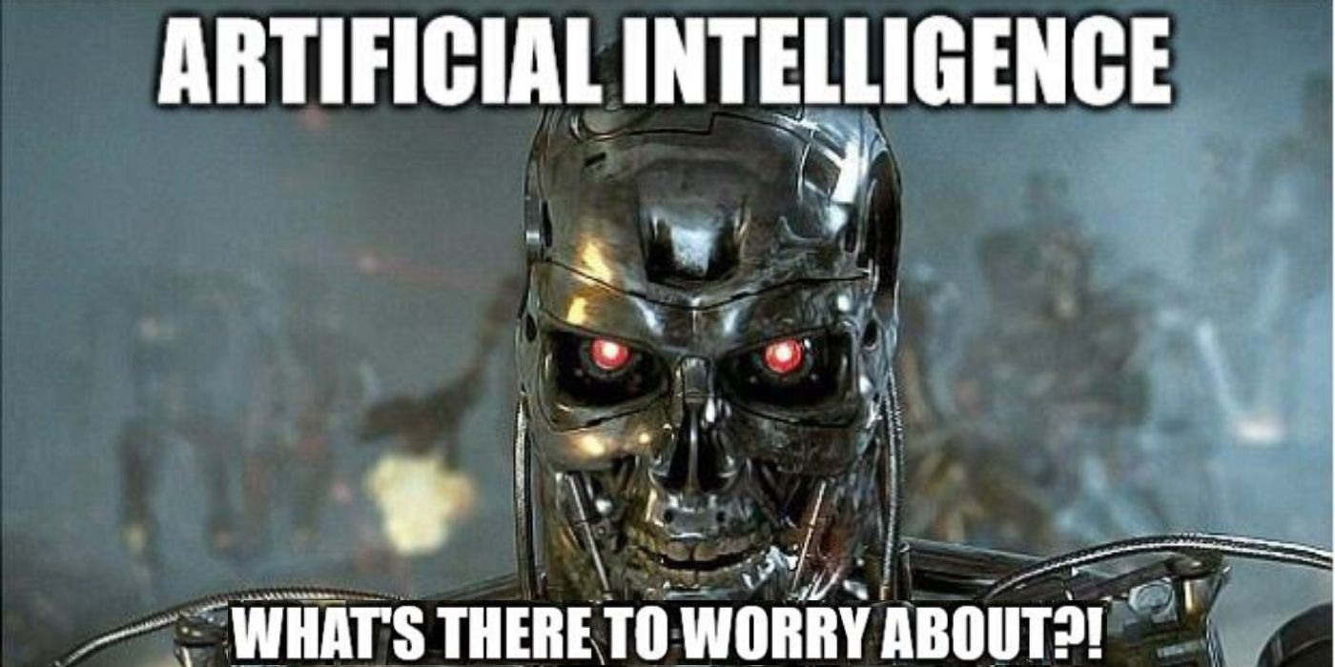

Slide 7
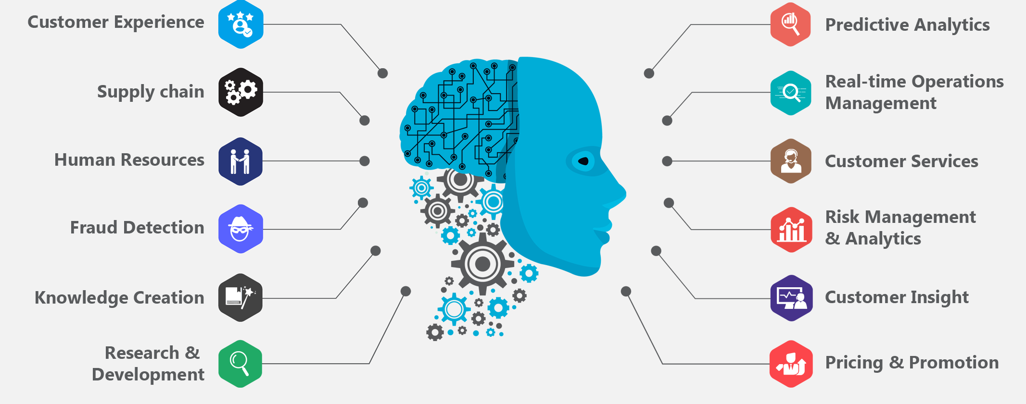
AI Scenarios

Slide 8
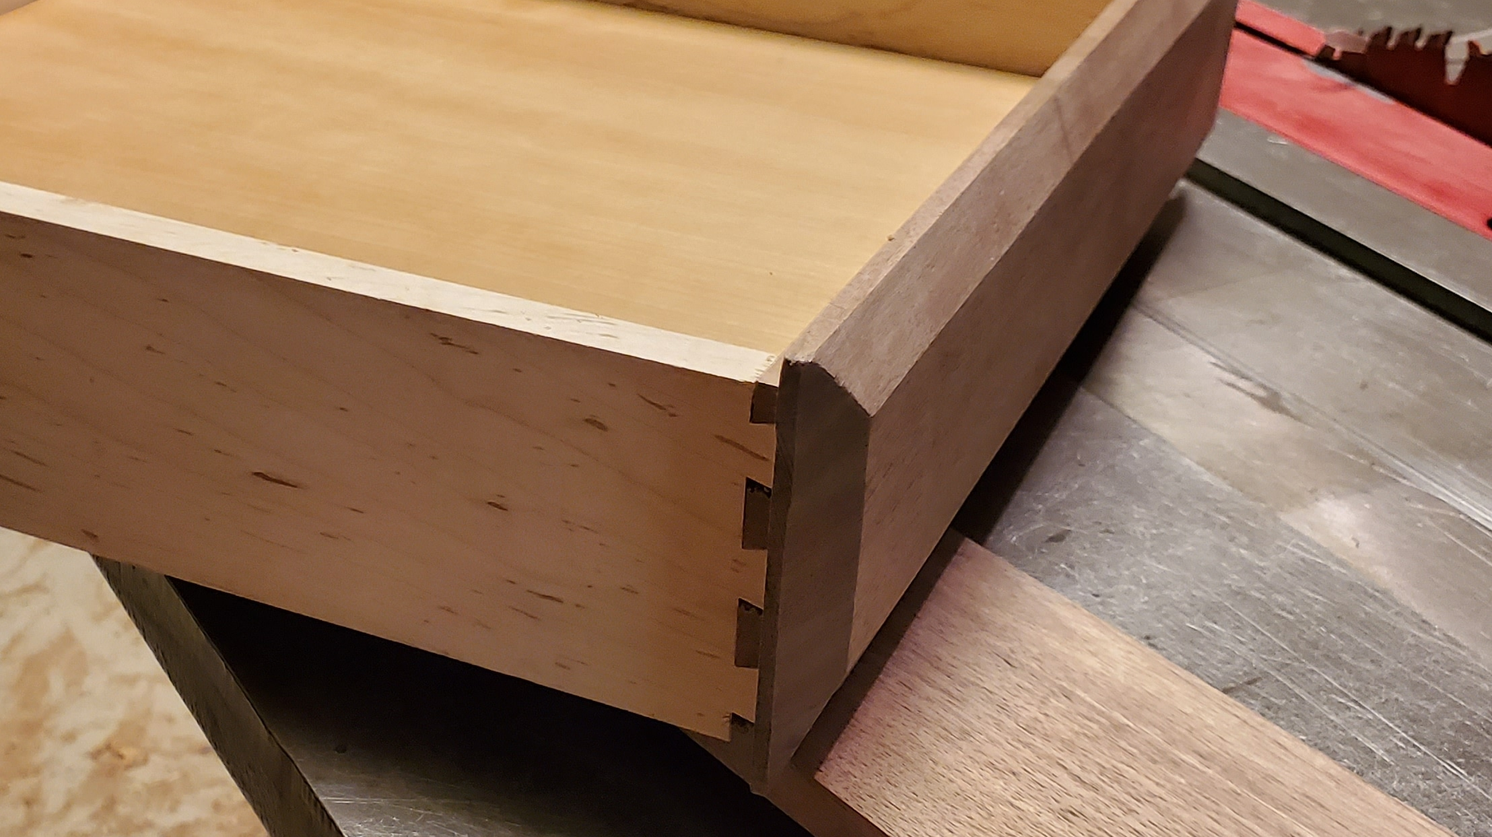
Dovetail jig

Slide 9
There are only 10 kinds of people those who understand binary and those who don’t.

Slide 10
Chatting with LMM’s
- Large Language Models predict what comes next
- Prediction engine
- What can AI do for me?

Slide 11
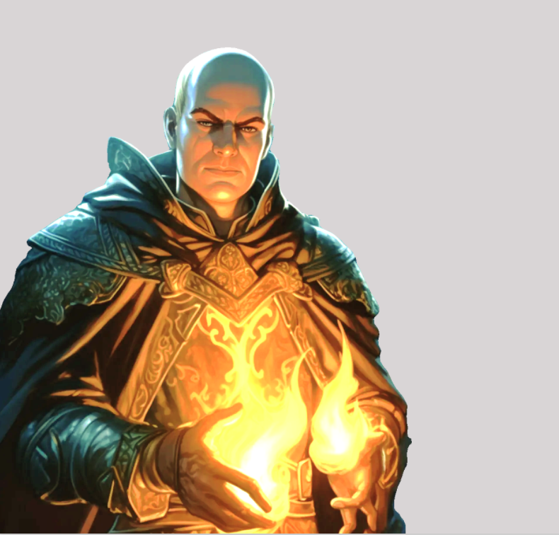
Prediction engine
What comes next?
What do I know about you?
How do I figure it out?

Slide 12
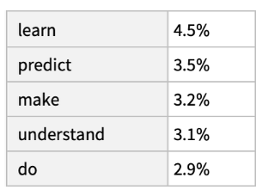
The best thing about AI is it’s ability to …

Slide 13
Prediction
The best thing about AI is its ability to,
The best thing about AI is its ability to learn,
The best thing about AI is its ability to learn from,
The best thing about AI is its ability to learn from experience,
The best thing about AI is its ability to learn from experience.,
The best thing about AI is its ability to learn from experience. It,
The best thing about AI is its ability to learn from experience. It’s,
The best thing about Ai is its ability to learn from experience. It’s not…

Slide 14
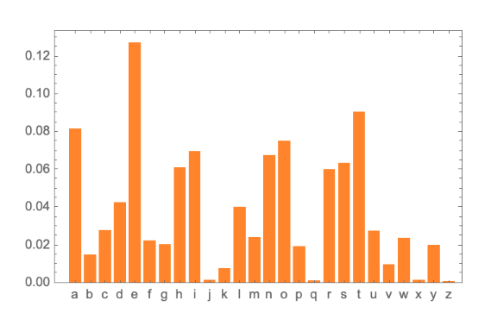



What comes next?

Slide 15
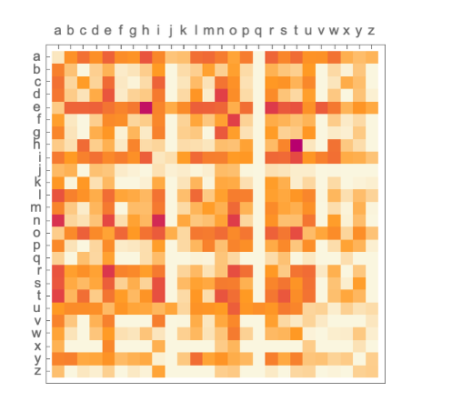

2-grams … i.e. pairs of letters

Slide 16
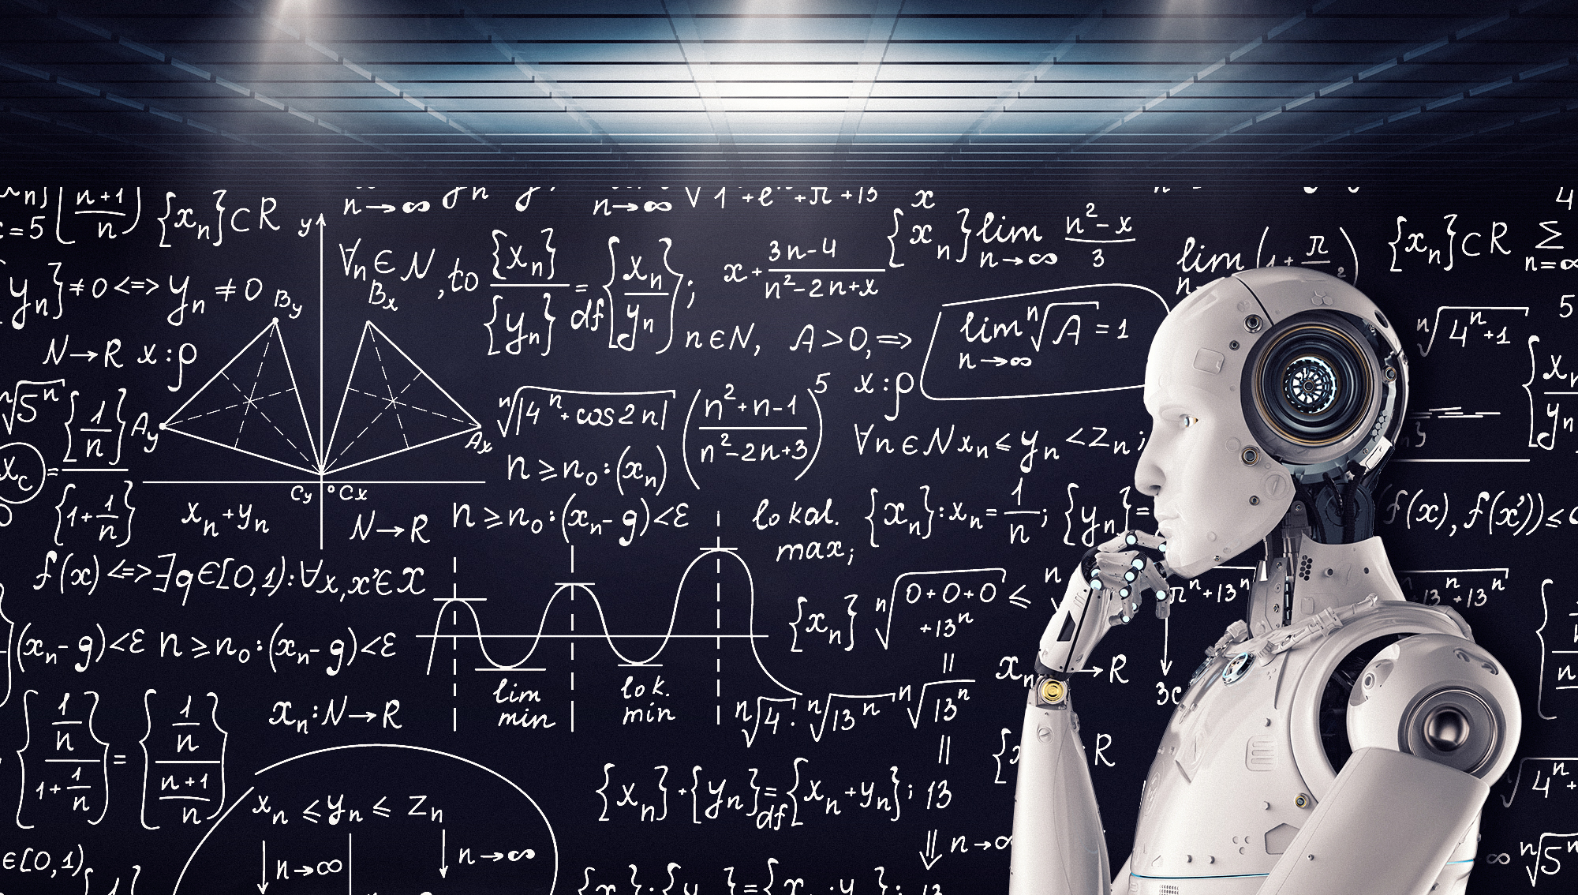
Built on Math

Slide 17
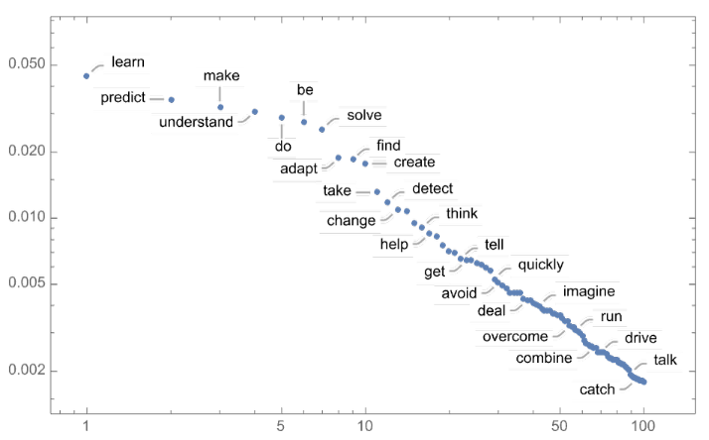
Power-law decay

Slide 18
Temperature
“The best thing about AI is its ability to learn from experience. It’s not just a matter of learning from experience, its learning from the world around you. The AI is very good example of this. It’s a very good example of how to use AI to improve your life. It’s a very good example of how to use AI to improve your life. The AI is a very good example of how to use AI to improve your life. It’s a very good example of how to use AI to…”

Slide 19
Lower the temperature…
The best thing about AI is its ability to learn. I’ve always liked the…
The best thing about AI is its ability to really come into your world and just…
The best thing about AI is its ability to examine human behavior and the way it…
The best thing about AI is its ability to do a great job of teaching us…
The best thing about AI is its ability to create real tasks, but you can…

Slide 20
Too low temperature?
“The best thing about AI is the ability to see through, and make sense of the world around us, rather than panicking and ignoring. This is known as AI “doing its job” or AI “run-of-the-mill” Indeed taking an infinite number of steps, developing a machine that can be integrated with other systems, or controlling one system that’s truly a machine, is one of the most fundamental processes of AI. Aside from the human-machine interaction, AI was also a big part of creativity…”

Slide 21
Prompts and Tokens
https://platform.openai.com/tokenizer
Vector Databases
RAG – Retrieval Augmented Pattern
Prompt Flow

Slide 22
GPTs (generative pre-trained transformer)
Provide text outputs in response to inputs
Code generation
Summarization
Conversation
Creative writing

Slide 23
Embeddings
A vector representation of a piece of data
Search
Clustering
Recommendations
Anomaly detection
Classifications

Slide 24
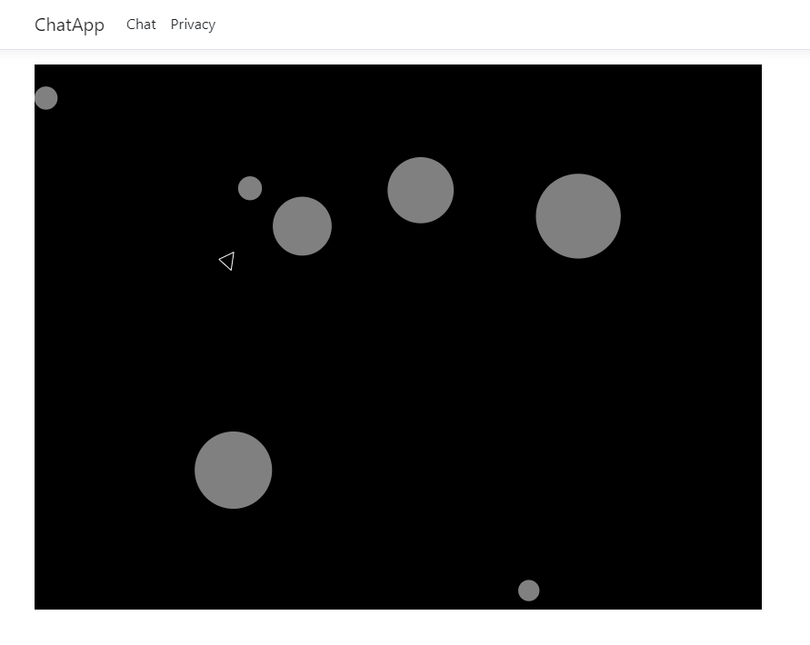
Let’s play a game

Slide 25
Automation (verb) Why spend 6 minutes doing something by hand when you can spend 6 hours failing to automate it?

Slide 26


Slide 27

Copilot
How can I help?
Pay atterntion…

Slide 28
Now is not the time for fear That comes later.

Slide 29

OpenAI Service

Slide 30
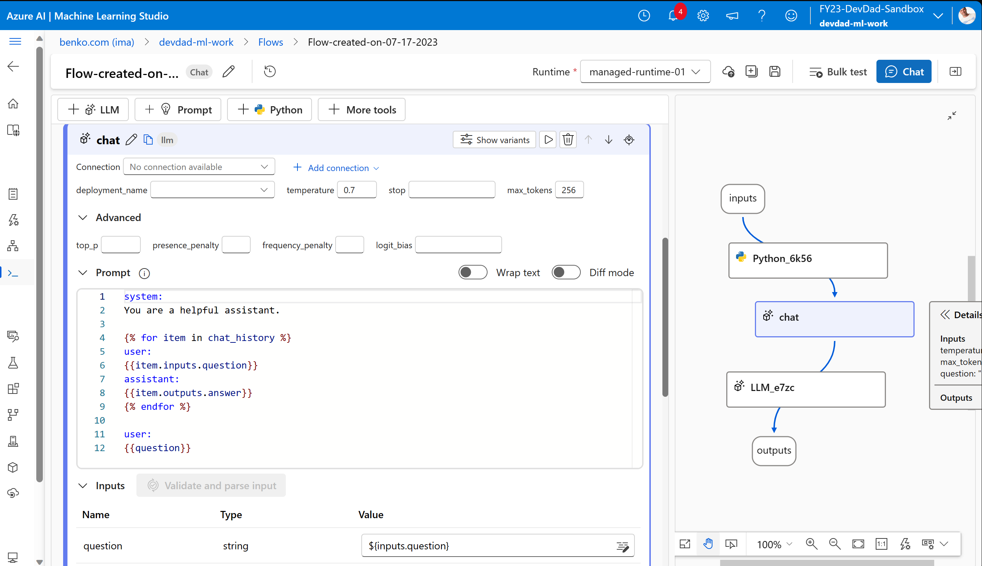
Promptflow

Slide 31
Lessons learned
Fear not…
Learn to ask better questions
Practice

Slide 32
Doing things right is not the same as Doing the right things

Slide 33
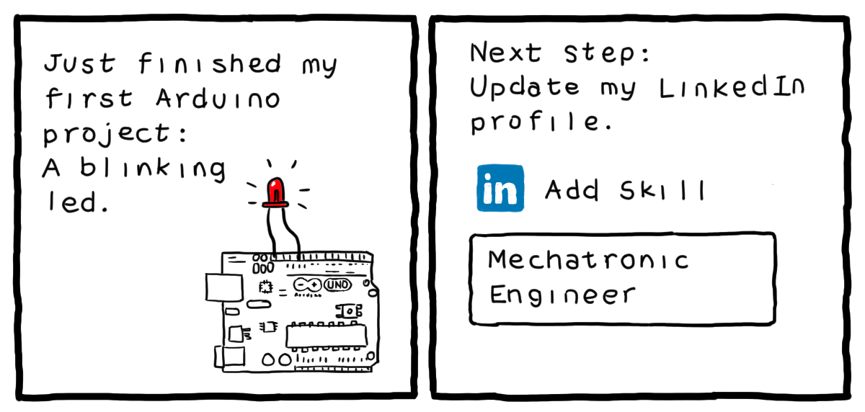
http://turnoff.us/geek/arduino-project/

Slide 34
Conclusion
The journey to the cloud can be challenging
Take it a step at a time
Be aware of the tools that can ease the way

Slide 35
Call to Action – Where can I get more info?
Visit my blog
www.benkotips.com
Schedule a workshop to make your IT workforce cloud aware
mike@benko.com
Try it out with low hanging fruit white chips

Slide 36
Life’s a journey, enjoy the ride!

Slide 37
References
What Is ChatGPT Doing … and Why Does It Work?—Stephen Wolfram Writings
Seth Juarez – Roshambo

Slide 38
